Slide 1

Covid’s impact on businesses and unemployment
Presented by:
Lyndsey Lewis & Pamela Donald

Slide 2
Lyndsey Lewis
Currently a Stay-at-home mom of three for the past 9 years.
Employment Background: Sales, Merchandising, Marketing, Dispatching, and customer relations.
Strengths: Team Player, Python
Hobbies: Traveling, Hiking, Gardening, Reading and Watching NWSL.

Slide 3
Pamela Donald
Currently Stay-at-home Mom
Employment Background: Software Development, Librarian, and Education Field
Strengths: Team Player, Software Development
Hobbies: Traveling, Reading, Salesforce Trailheads and Watching NBA Basketball Games

Slide 4
Methods
Python
Gather and Mold our Data into workable information
Merge different Datasets .
We tested our Data in Chi Square, Anovas, Linear Regression, and Normal Distribution.
We graphed parts of our Data with Histograms, Pair Plots, Scatter Plots, and Tableau

Slide 5
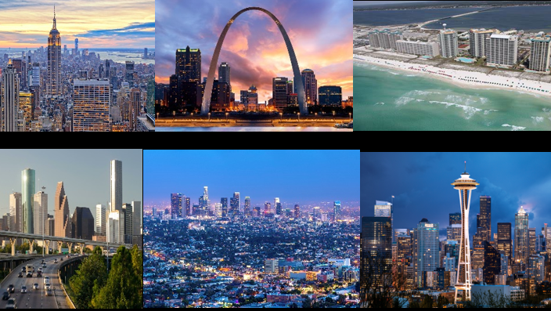
Business
Covid’s affect on the country’s businesses were ravaging to the economy and certain states were hit harder than others. Although some states rebounded faster than other, businesses are still struggling with opening businesses. The following states were measured New York, California, Florida, Lousisana, Hawaii, Missouri, Washington State, Georgia, and Texas.

Slide 6
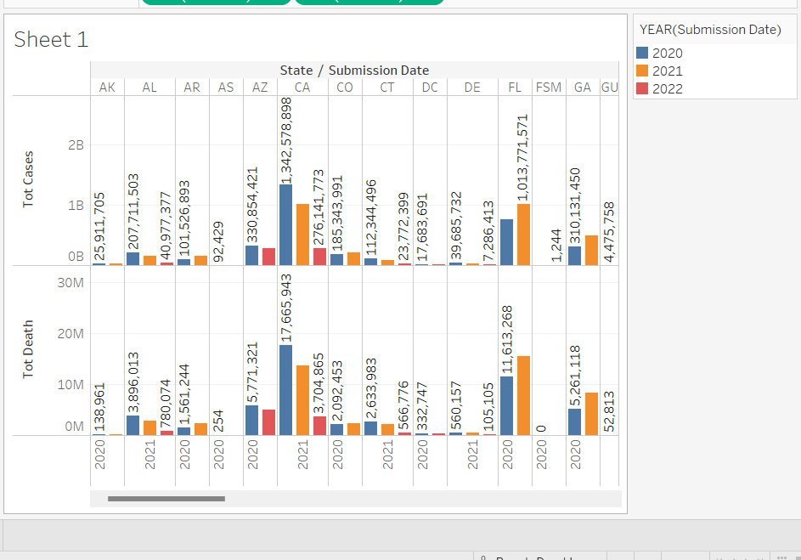
The Beginning of Covid
January 2020, we saw the first few cases of Covid emerge in the States.
April 2020, most states were in some form of lockdown which hurt the businesses greatly. Businesses were closing or under mandates. Schools went to virtual learning. It was catastrophic to our economy. As the total cases skyrocketed also did the net change in businesses.

Slide 7
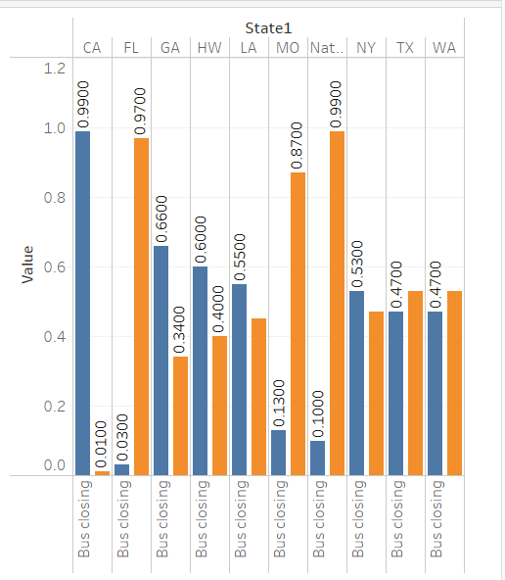
Business Openings and Closings
Between May and July 2020 stay at home mandates were lifted , but masks were enforced. Businesses started opening up, and the economy started to revive.
Covid cases were still high but states like Florida and Texas never really followed protocols and mandates. Florida and Missouri rebounded quickly while states like California, Hawaii, and Lousiana are still trying to rebound from the pandemic. States like New York is rebounding slowly with less than 53% closed and 47% open.
As of April 2022, all states are open with no mask mandates and national net change of businesses closings at less than 50%.
Vaccines and the mask mandates helped bring down the Covid cases and deaths which helped boost the net change of businesses between 2020 and 2022.

Slide 8
Unemployment
Covid’s affect on the country’s employment was devastating, although some states faired better than others. The six state we will exploring are California, Texas, Missouri, Florida, New York, and Washington.

Slide 9
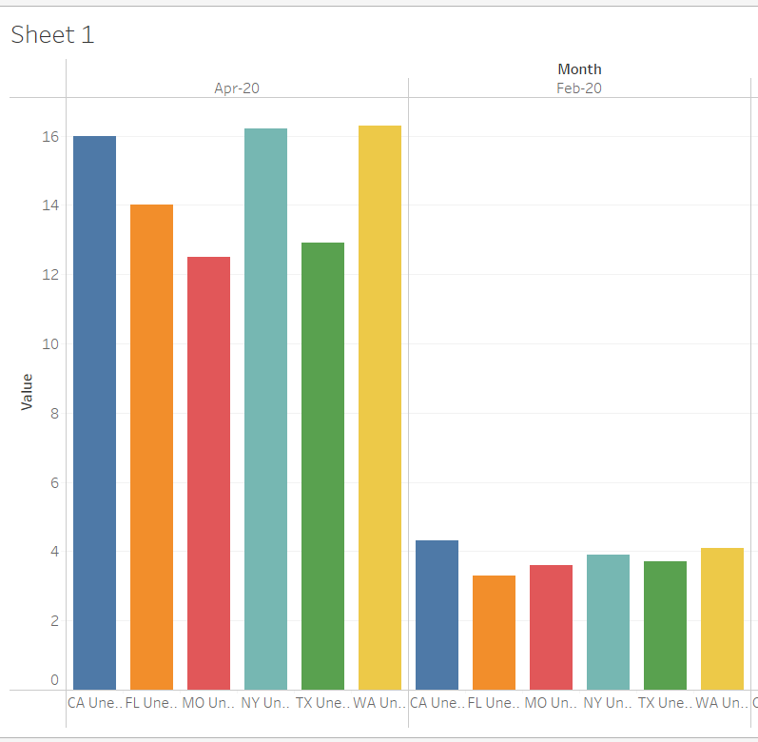
The Beginning of Covid
February 2020, we saw the first few cases of Covid emerge in the States.
April 2020, most states were in some form of closure due “stay-at-home-mandates”.
The Restaurant industry was one of the hardest hit with 5.5 Million people nation wide losing jobs in April.
Had the highest amount of unemployment since ‘The Great Depression’.

Slide 10
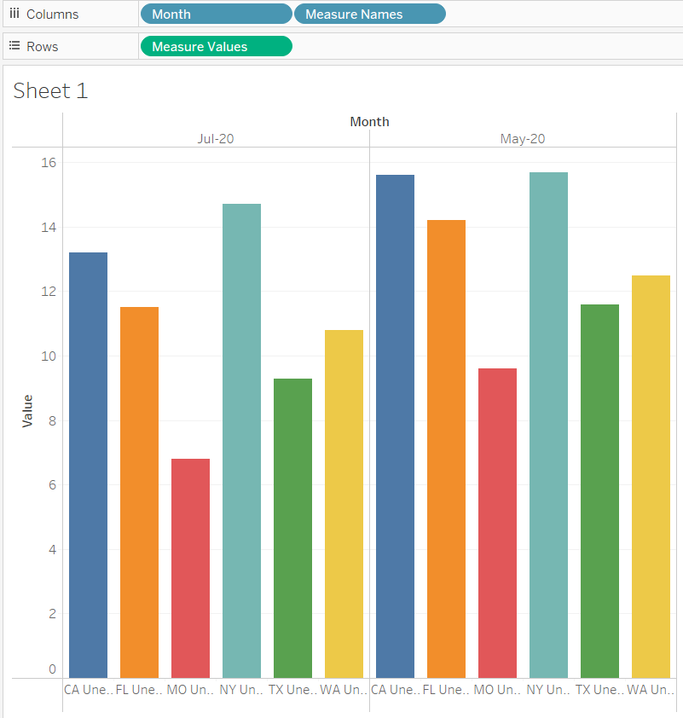
Mask Mandates
Between May and July 2020 S.A.H mandates expire and mask mandates were put in place.
Missouri Completely reopened but with mask mandates in place and social distancing.
Florida, and Texas opening at 25%
California is on indefinite S.A.H
New York Extended their S.A.H.
Washington opening very slowly.

Slide 11
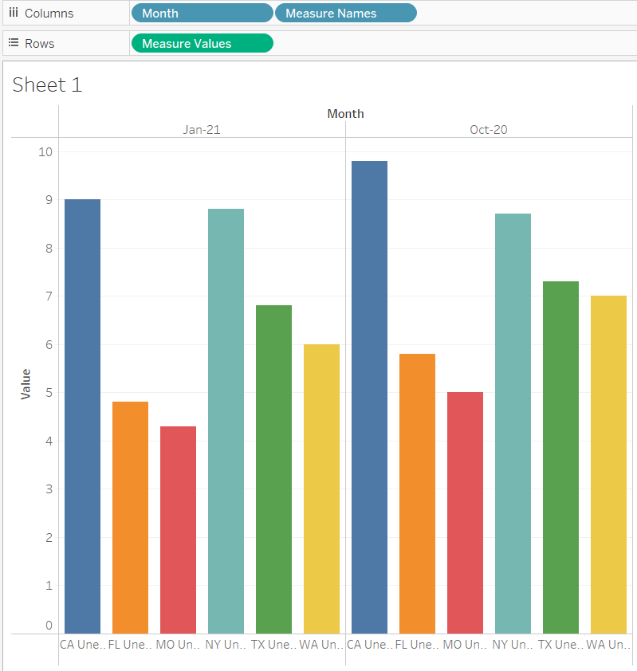
Vacinne Rollout
Between October and January 21 three different vaccine’s were approved and put in circulation.

Slide 12
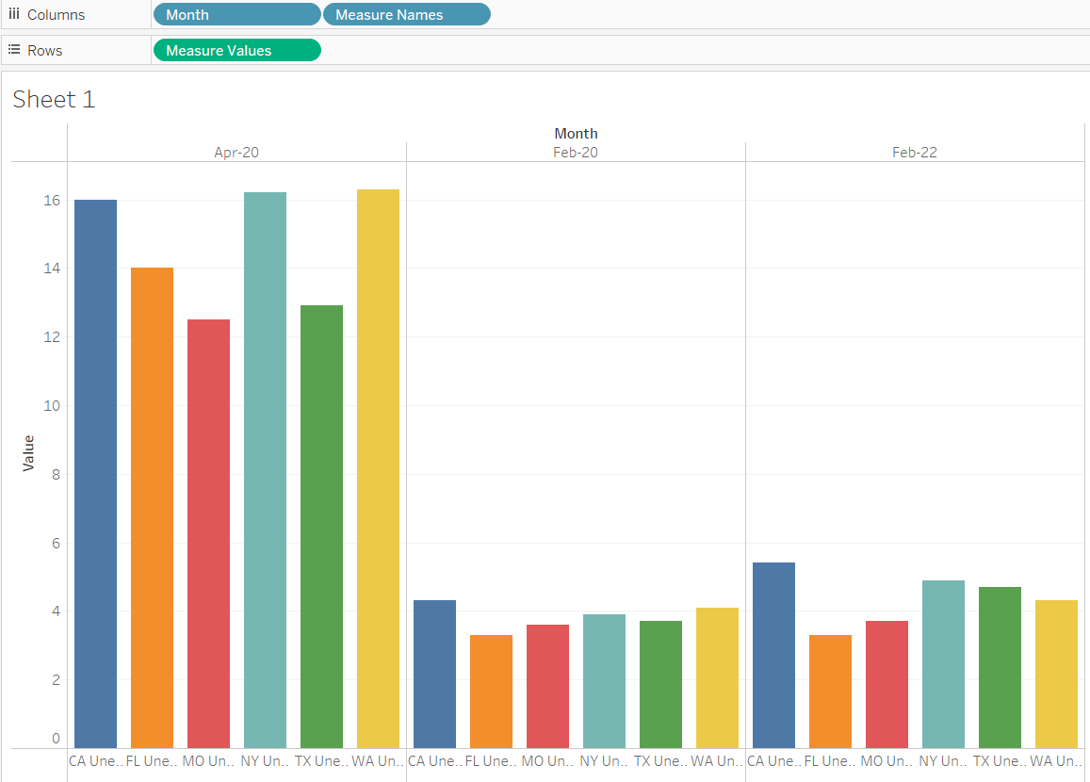
Beginning to End
Surprisingly after two years of uncertainty we can see the 6 states I’ve chose are all recovering rather quickly.

